Slide 1

Genre and Platform Sales Performance Across Regions from 1980-2005
Daniel Sterling
Aaron Suarez
Ivelisse Montero

Slide 2

Thesis
Our study will analyze the sales performance of video games across genres and platforms through different regions, identifying shifts in genre and platform popularity and their correlation with the regions they are sold in.

Slide 3
Platform Sales
What Platforms have the highest sales?
What Platforms are most prominent in each major region?

Slide 4
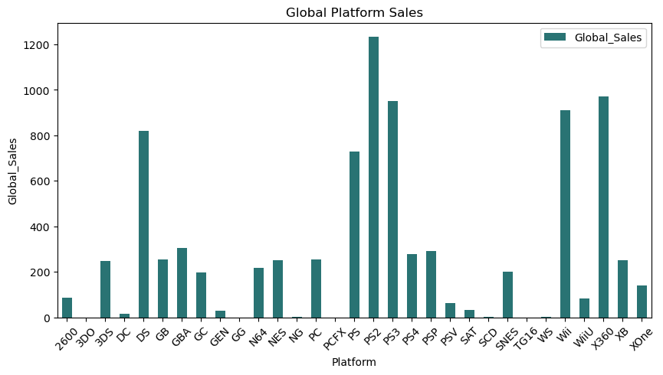
Global Platform Sales

Slide 5
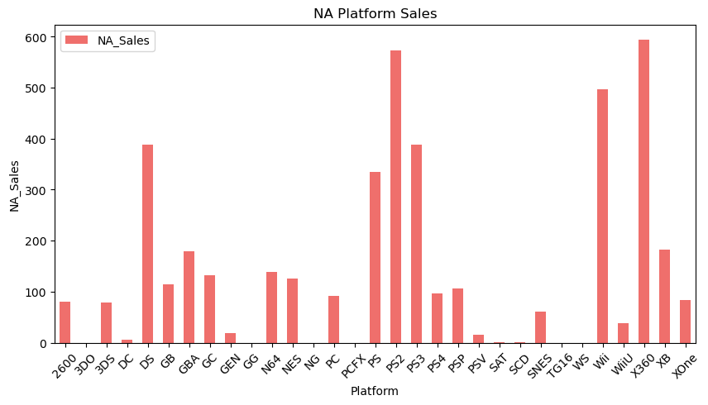
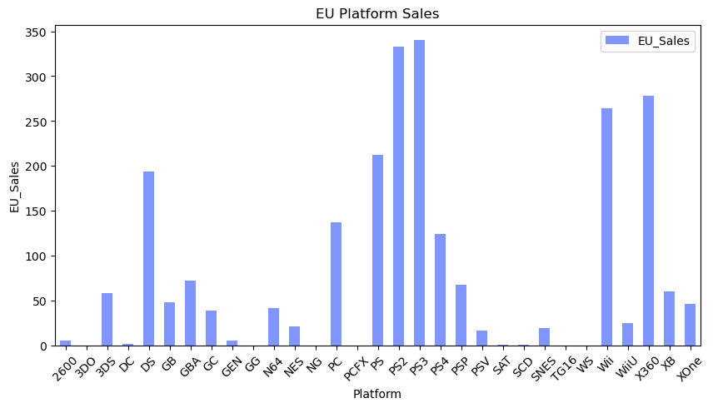
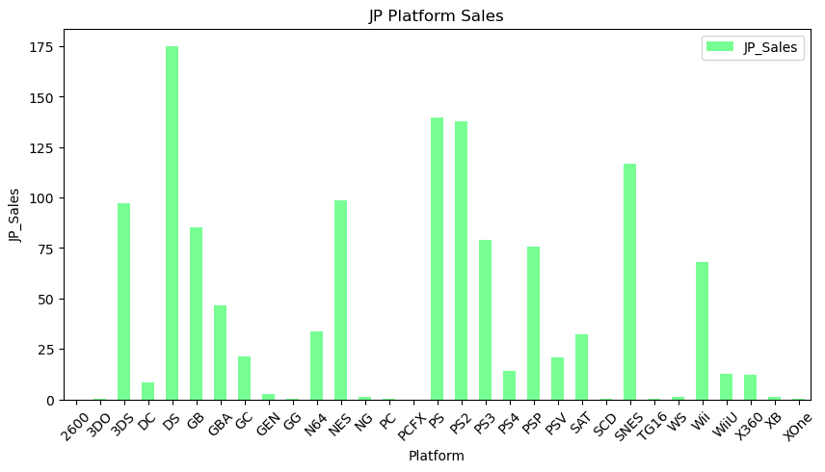
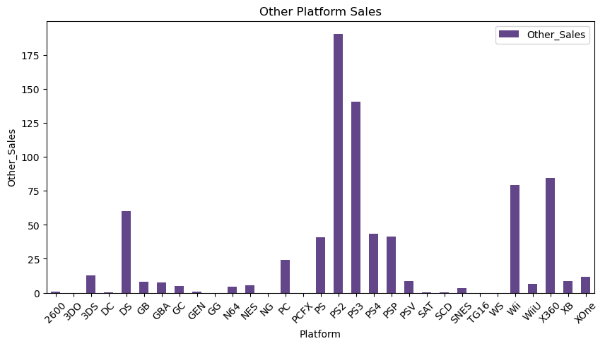
Platform Sales by Region

Slide 6
Genre Sales
What Genres have the highest sales?
What Genres are most prominent in each major region?

Slide 7
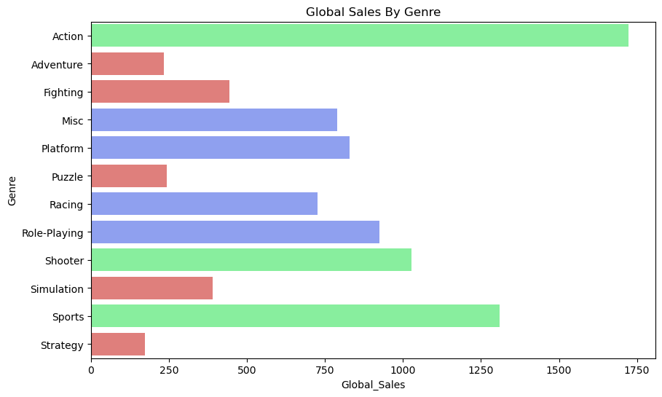
Global Genre Sales

Slide 8
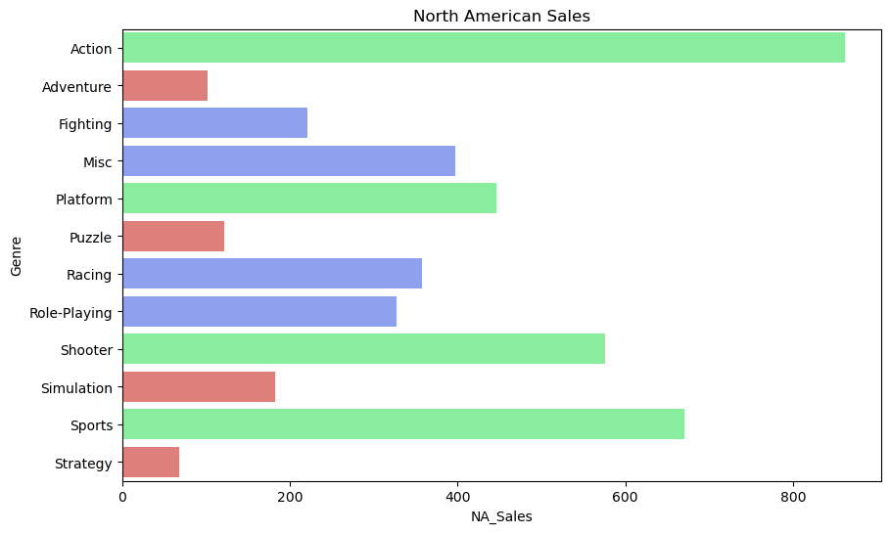
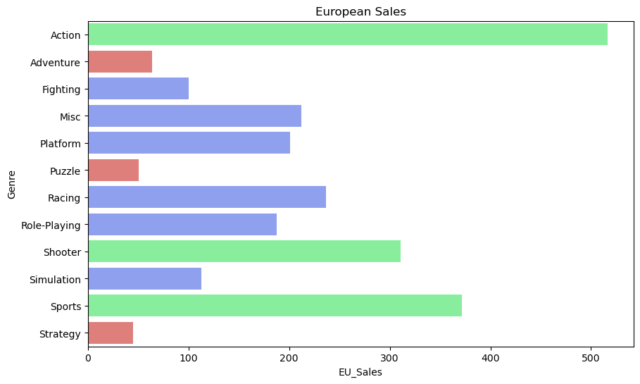
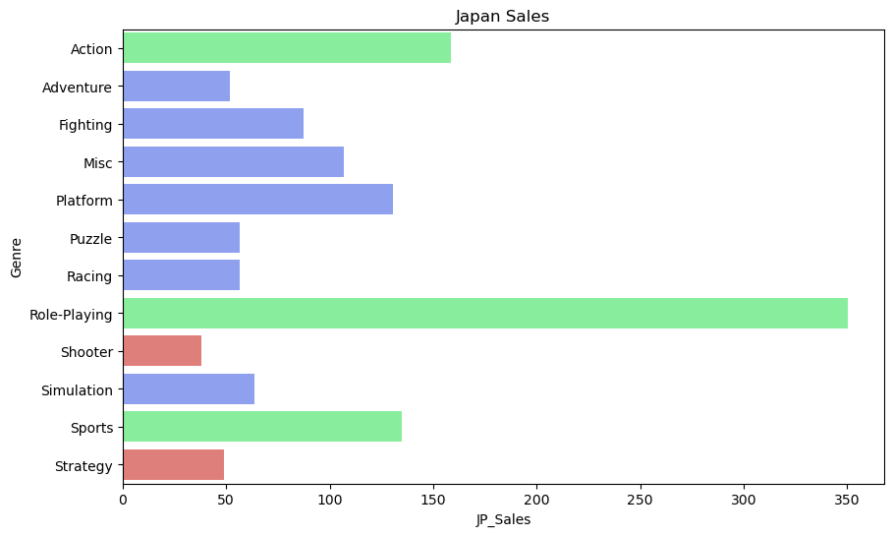
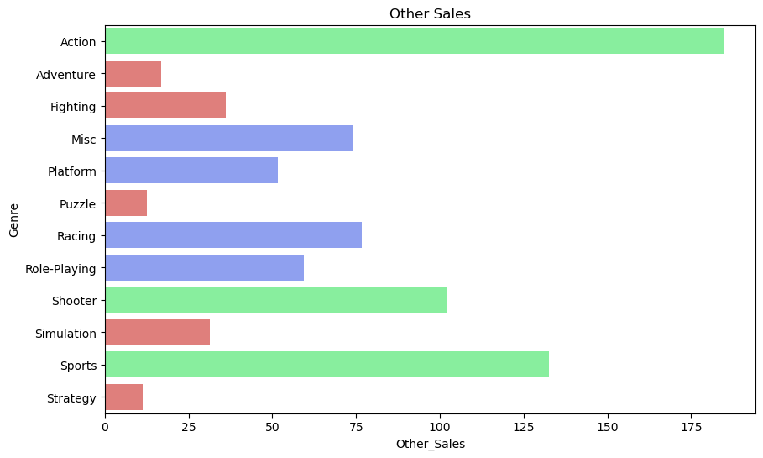
Genre Sales by Region

Slide 9
Major Contributions to Genre Sales
What were the three main genres seen in our data set?
What countries contribute most to these genres?

Slide 10
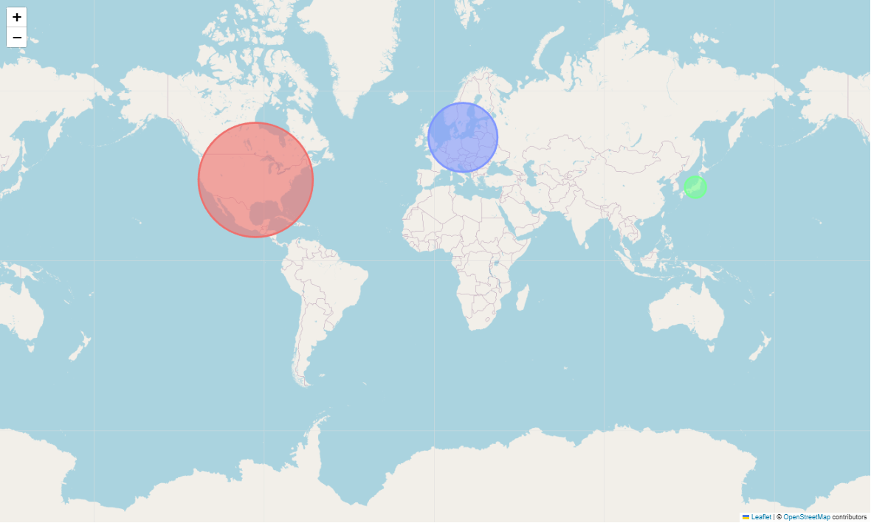
Action

Slide 11
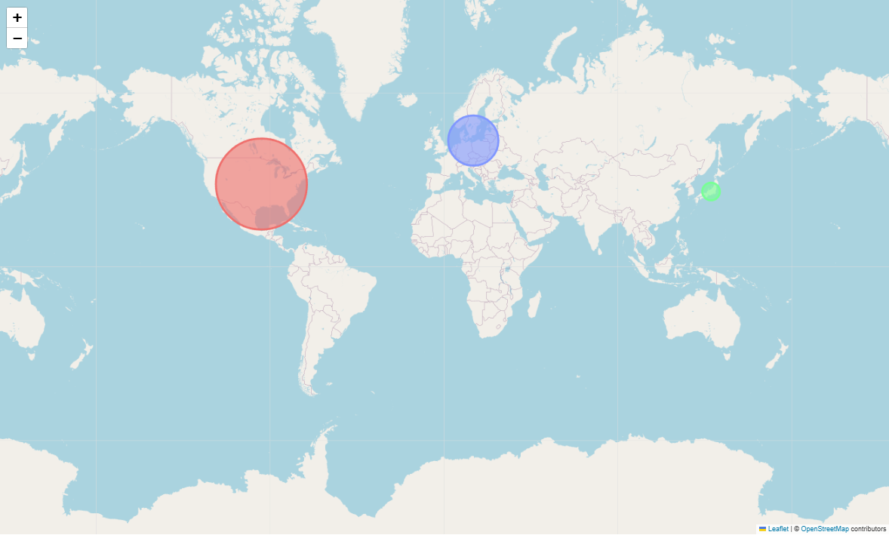
Sports

Slide 12
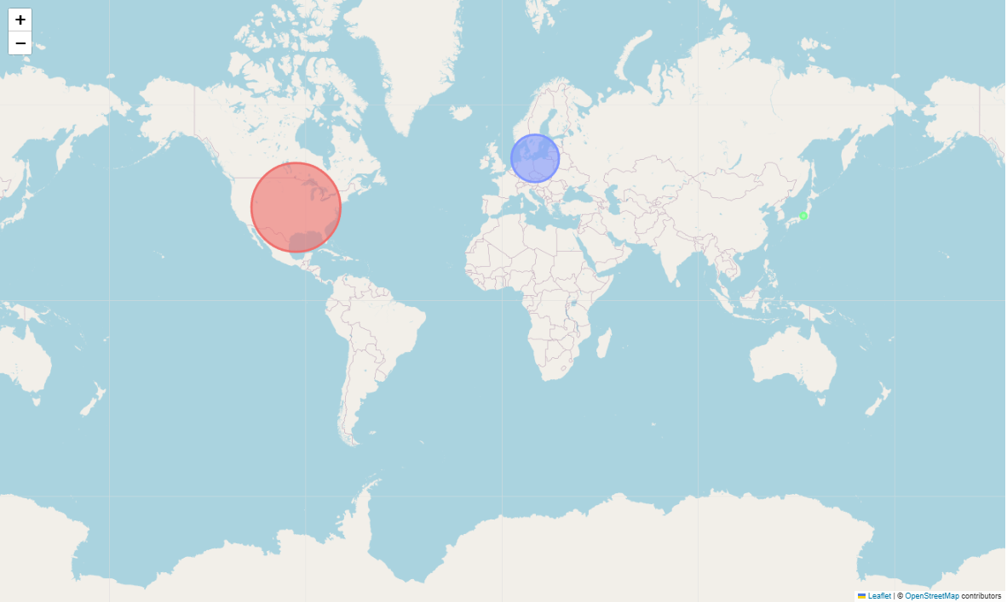
Shooter

Slide 13
Correlation Between Years and Sales
Does the year a game is release effect its sales?
What were the peak years for video game sales?

Slide 14
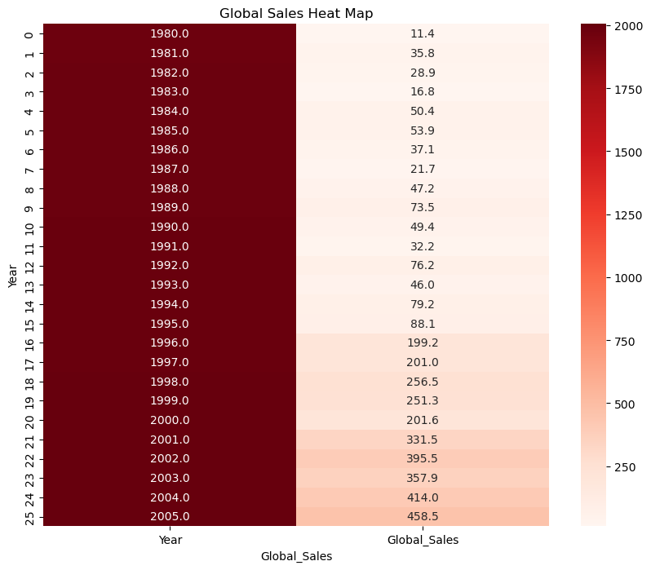
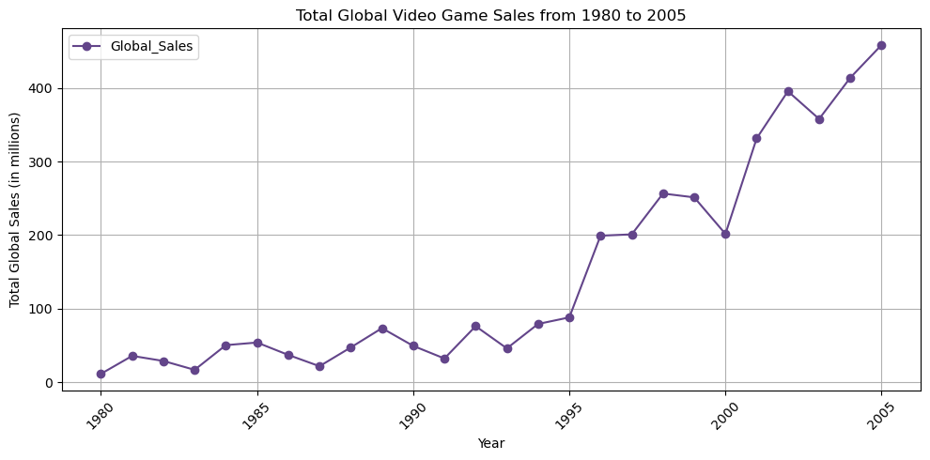
Global Platform Sales

Slide 15
Call to Action
Based of our Analysis of the Data Set we have concluded that if a new game were to included elements of Action, Sports, and Shooter games, while also ensuring that they focus marketing on North America and Europe, that game would have the best foundation for success.

Slide 16
Bias and Limitation
The major bias of our data set is platforms. Certain games could have likely found more success had they been made available on other Platforms. This is the case with Japan's Platform Sales.
The major limitation to our data set is not having indications for a game being part of a long running series. This would heavily affect the popularity of a release.

Slide 17
Future Work
Companies like Microsoft would benefit from looking at sales in Japan, such as Role-Playing Games (RPGs), which would increase their overall sales output.
America and Europe both have identical sales trends for both Platforms and Genres, so marketing similarly in both of those regions will benefit game developers.

Slide 18
Work Cited
https://www.kaggle.com/code/upadorprofzs/eda-video-game-sales
https://chatgpt.com/
Kaggle is the source of our Data set, and Chat GPT was referenced throughout our presentation to formulate our thesis as well as understand our Bias and Limitation.

Slide 19
Q&A

